Slide 1
AIM Integration Framework and the Custom Menu Feature
Neville Allen
Jeremy Fowler

Slide 2


Presenters
Neville Allen
Jeremy Fowler
Development Manager
Vertafore
Senior Technical Operations Architect
RT Specialty

Slide 3
AIM Integration Framework
Way for AIM to integrate with external systems
Used to create custom menu commands
One-way transfer from AIM into an external system

Slide 4
Prepare Aim Integration Framework
Install the .NET Framework version 4
Run installation file named AimIntegrationInstaller.msi
Run the database change scripts to create the tables
Configure the commands in the AIMIntegrationMap table

Slide 5
Enable the Settings in the DMU

Slide 6
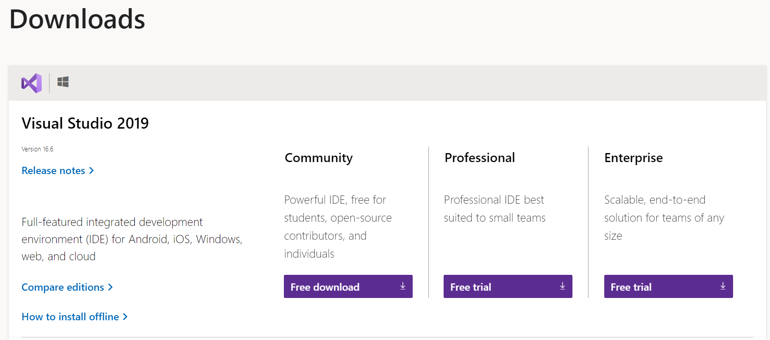
Install Visual Studio 2019
https://visualstudio.microsoft.com/downloads/

Slide 7
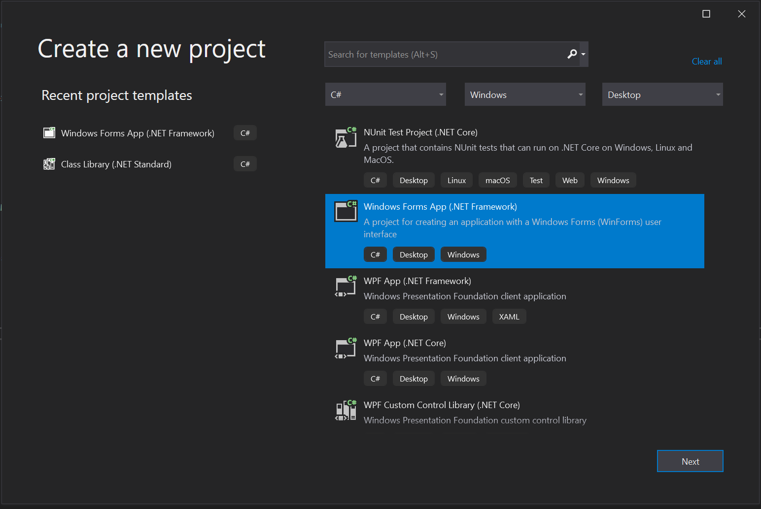
Create a New Windows Forms App Project

Slide 8
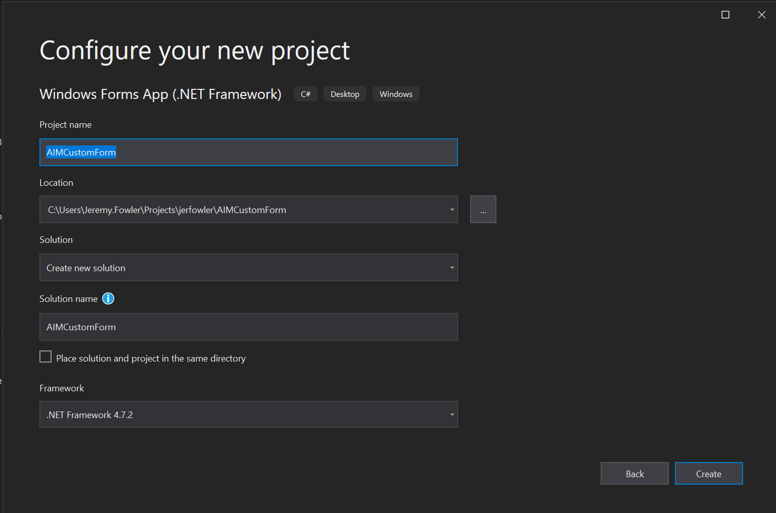
Configure Your New Project

Slide 9
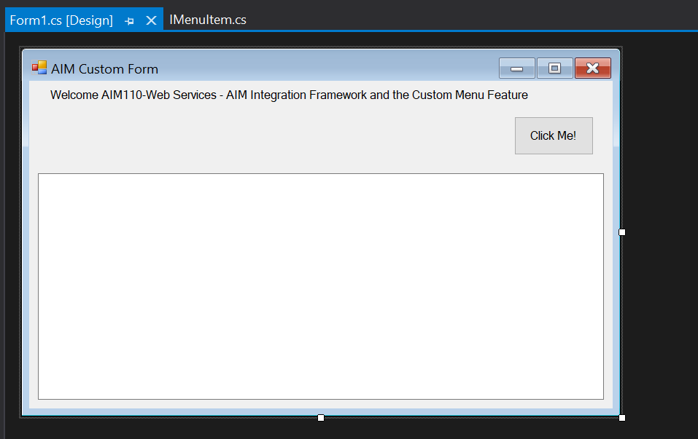
Design Your Form

Slide 10
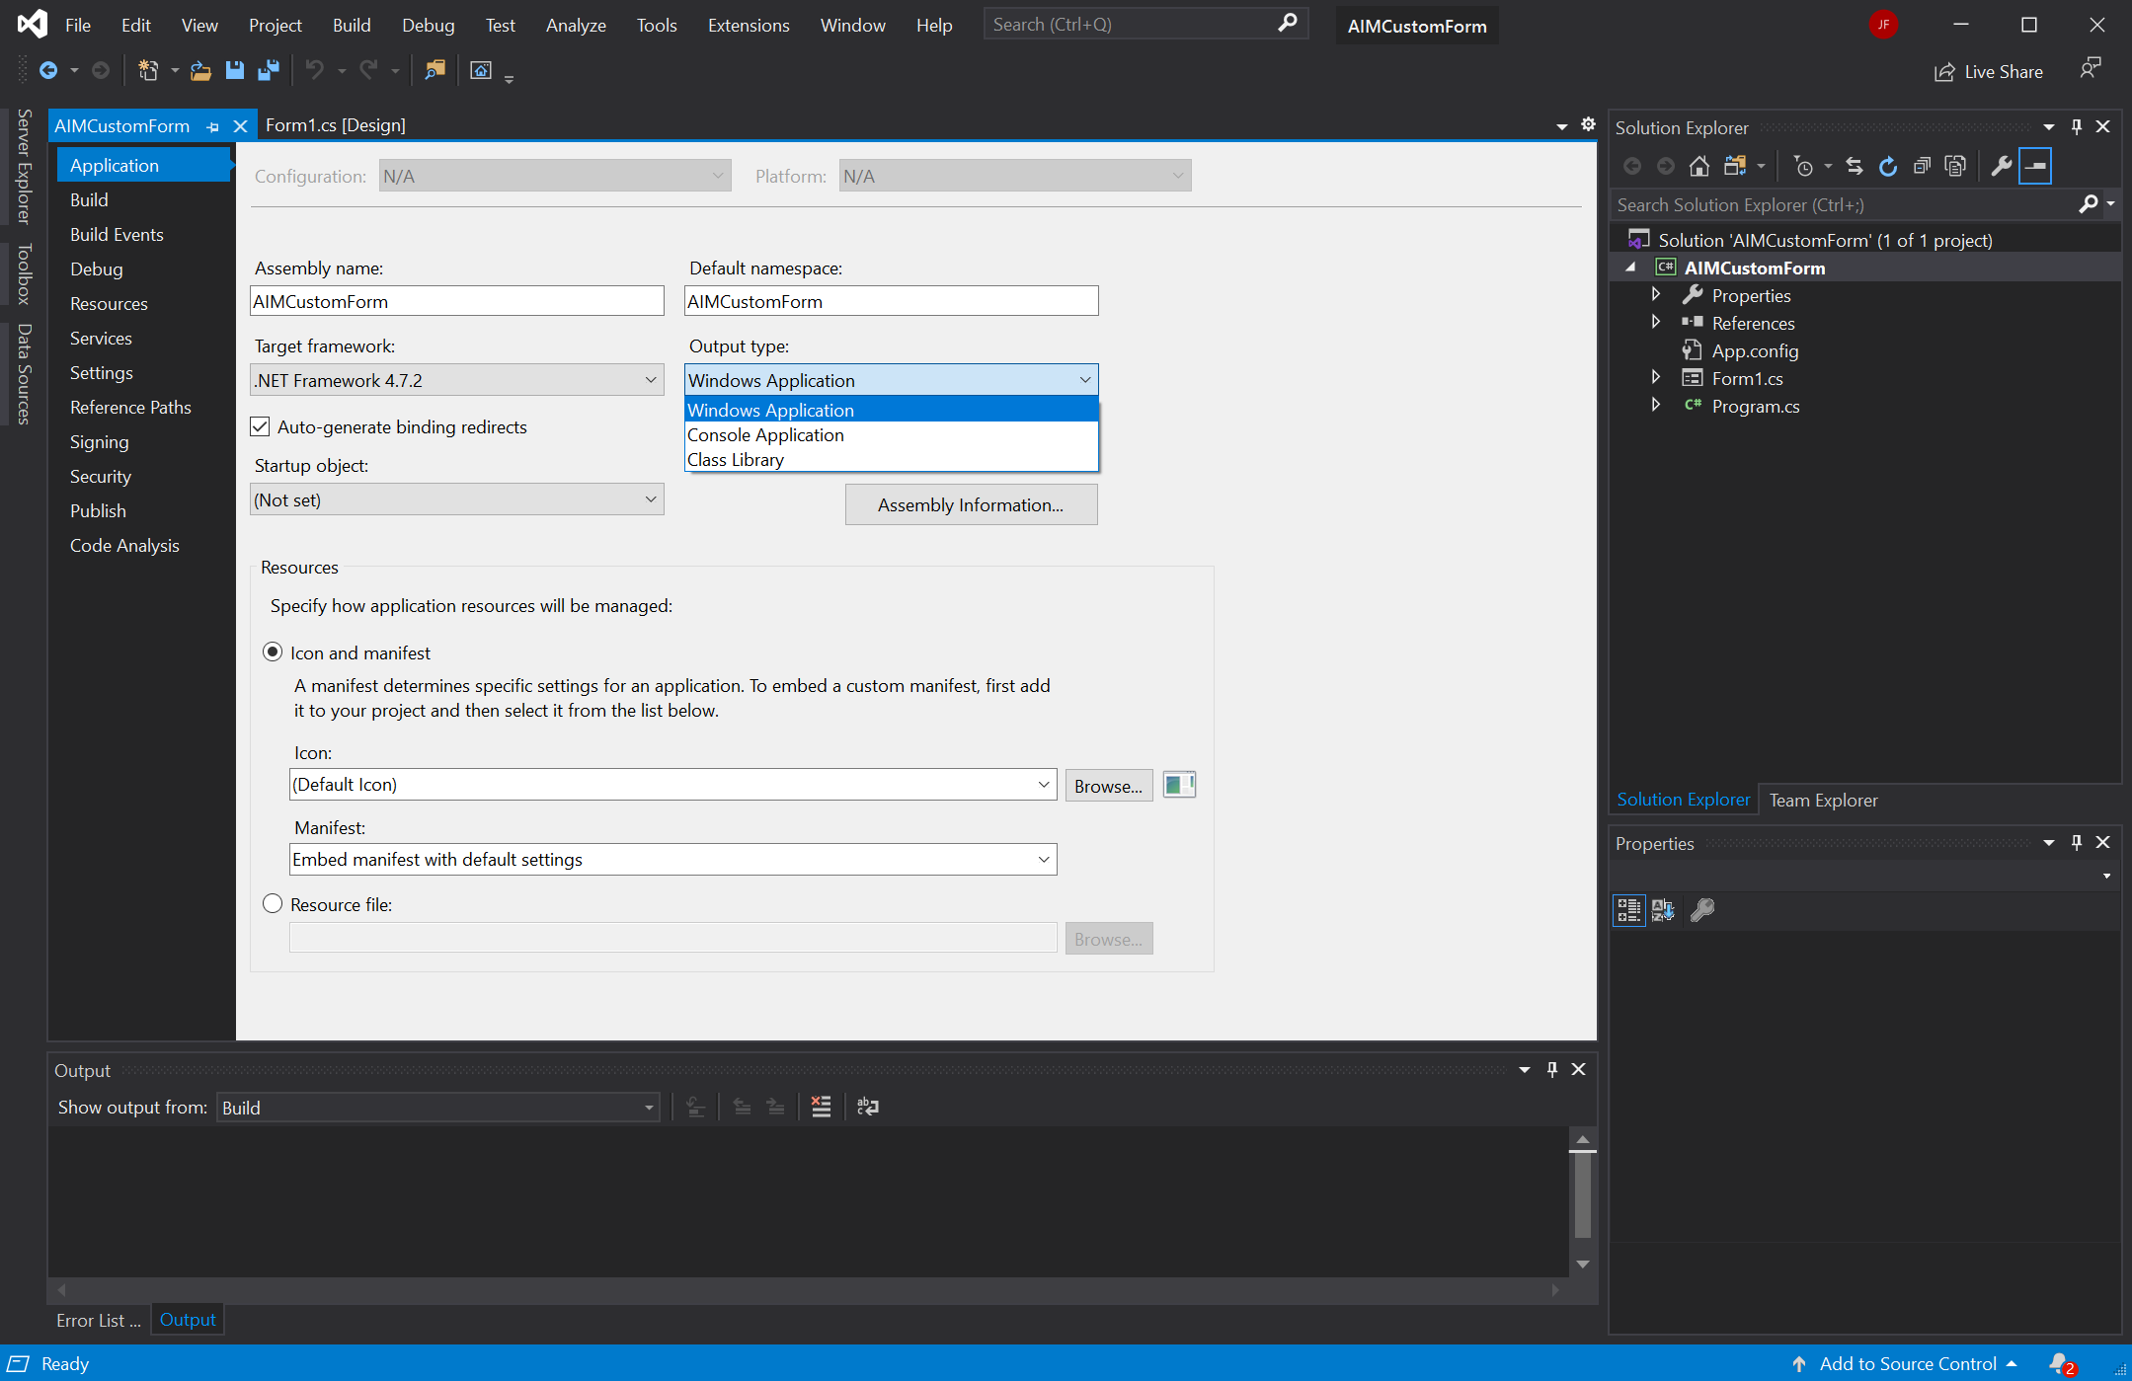
Change Output Type to Class Library

Slide 11
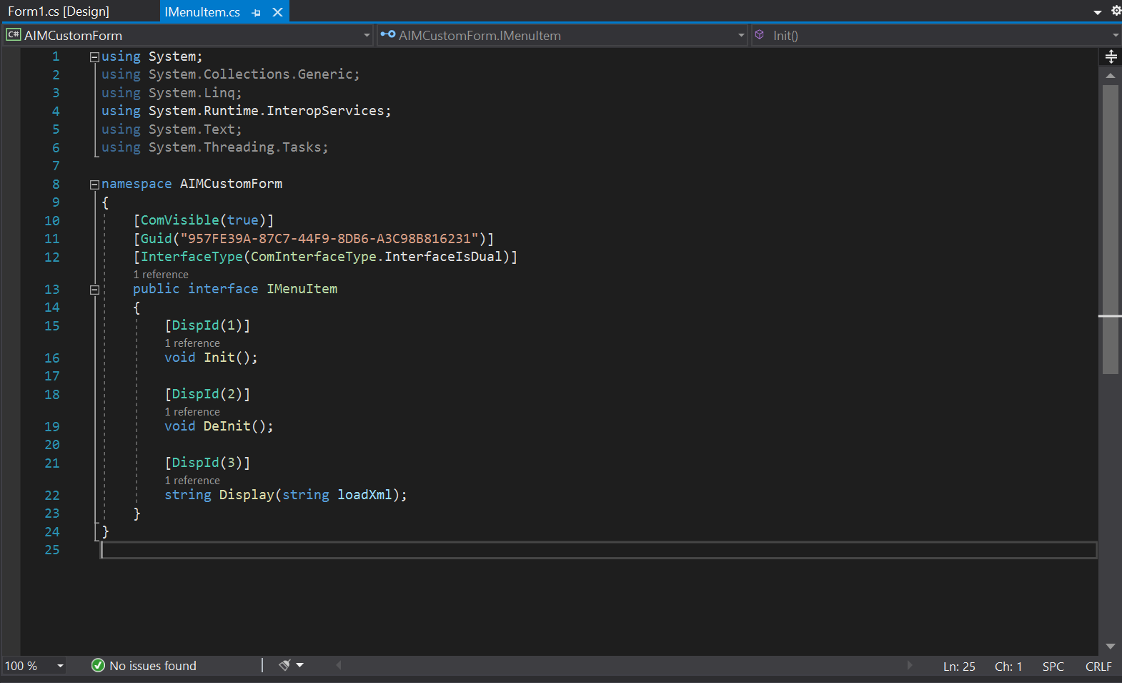
Create a new IMenuItem.cs File

Slide 12
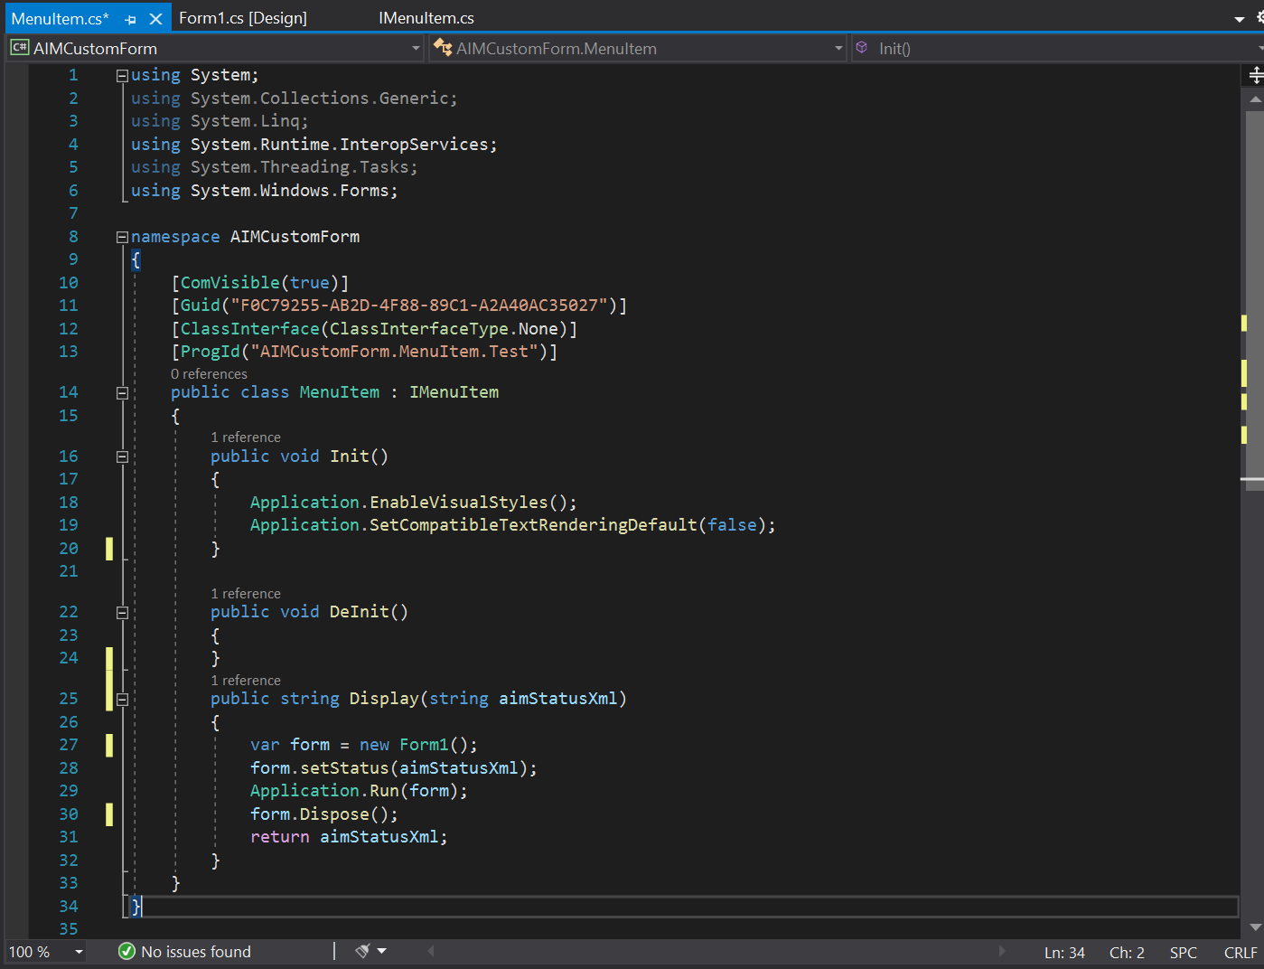
Create a new MenuItem.cs File

Slide 13
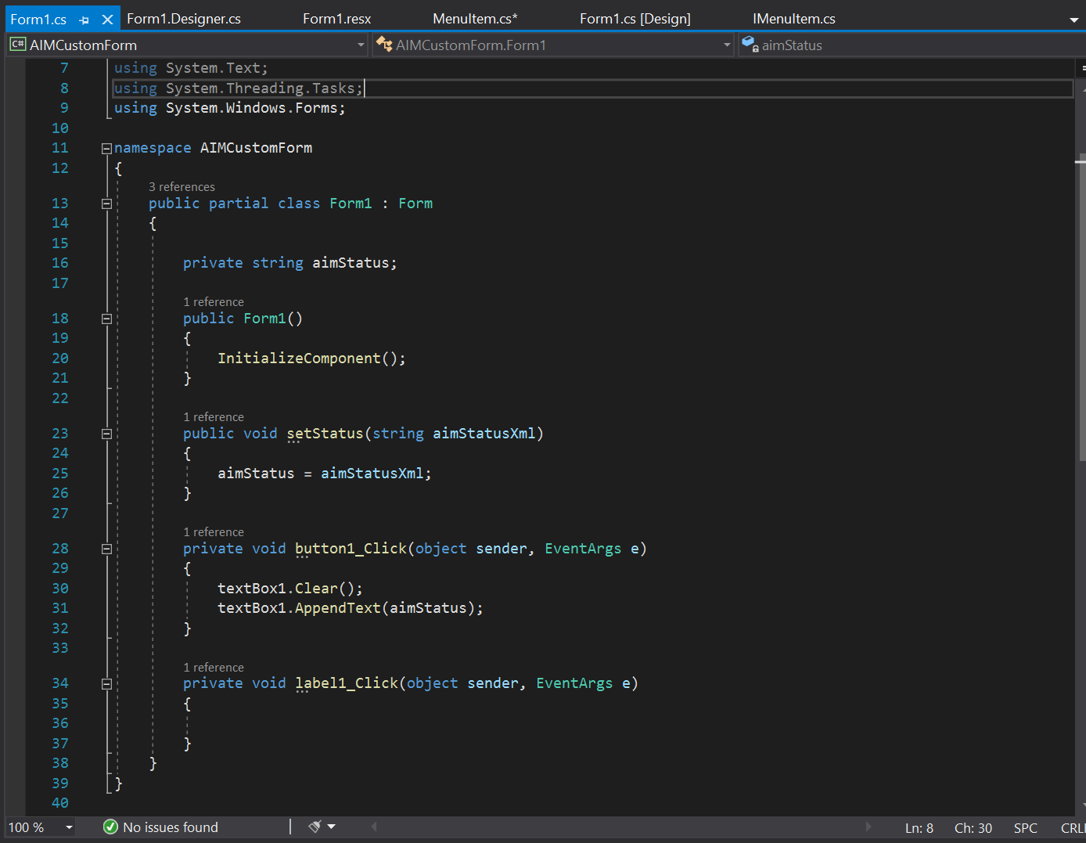
Modify the Form Logic

Slide 14
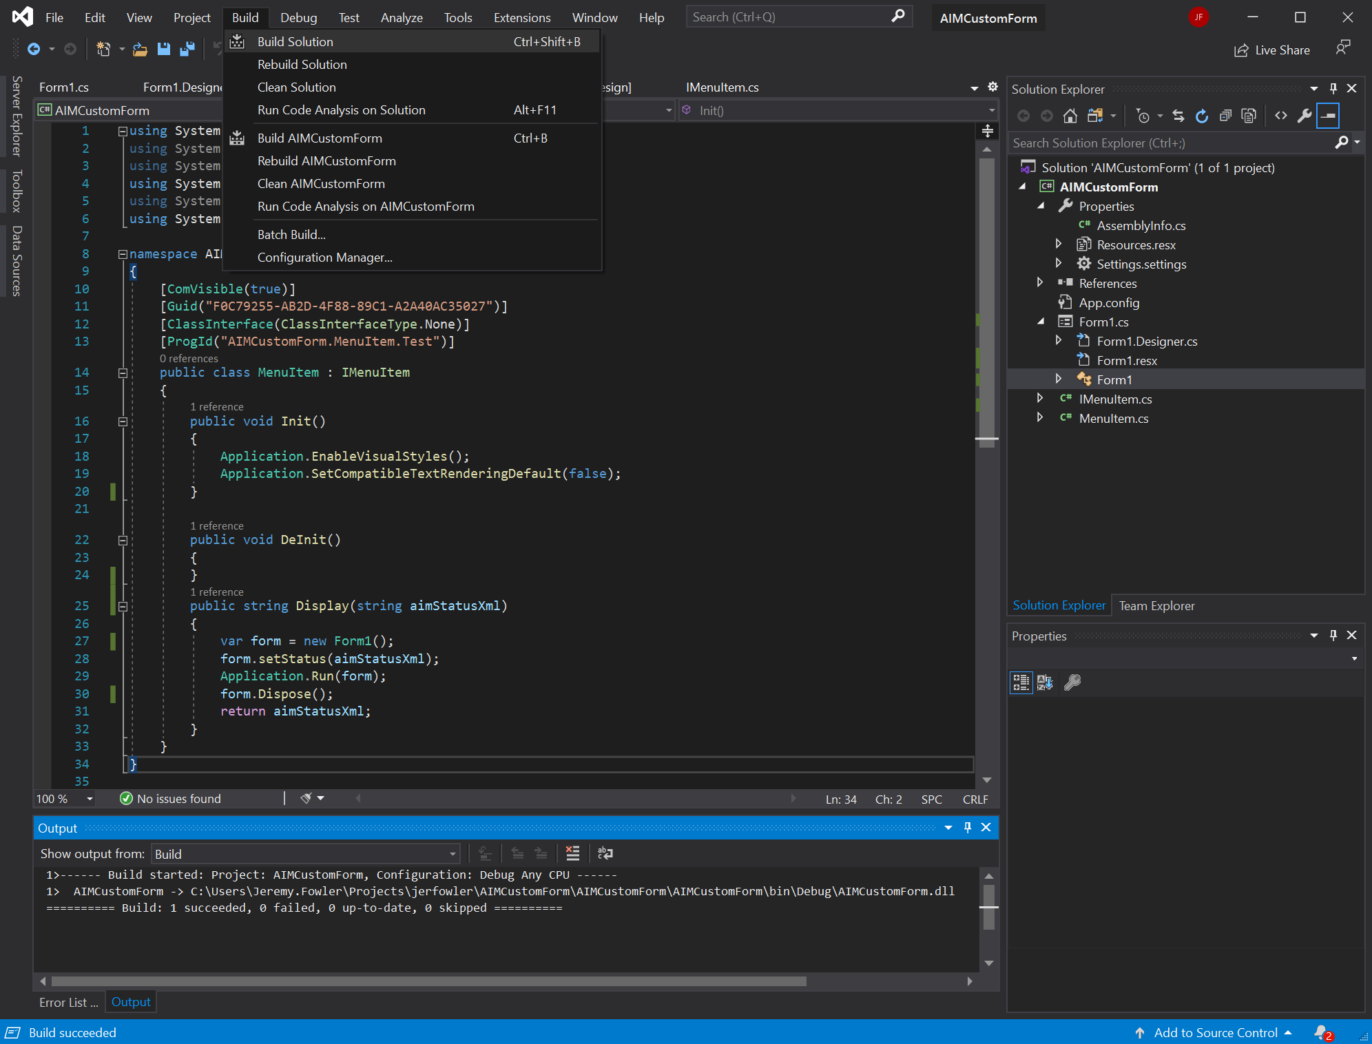
Build the Library DLL

Slide 15
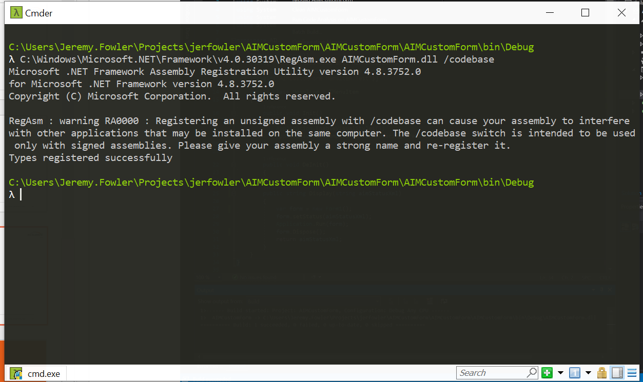
Register the Assembly (DLL)

Slide 16
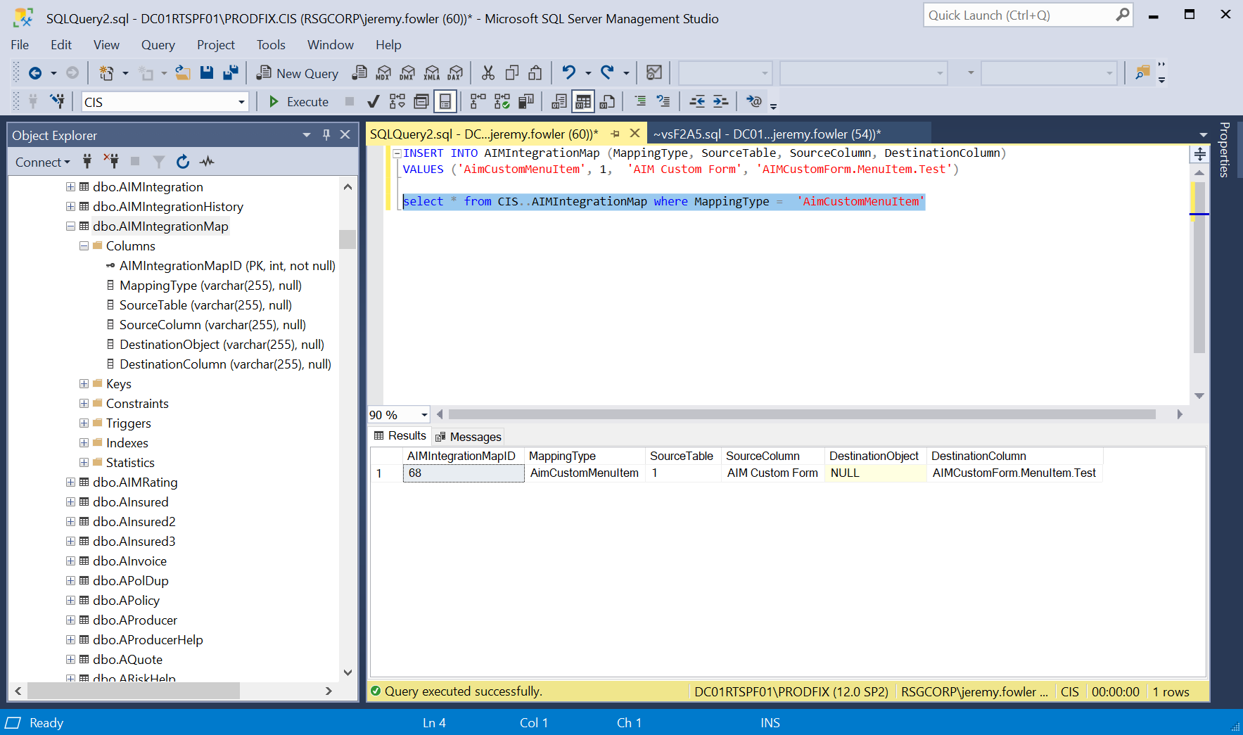
Insert the AimCustomMenuItem record

Slide 17
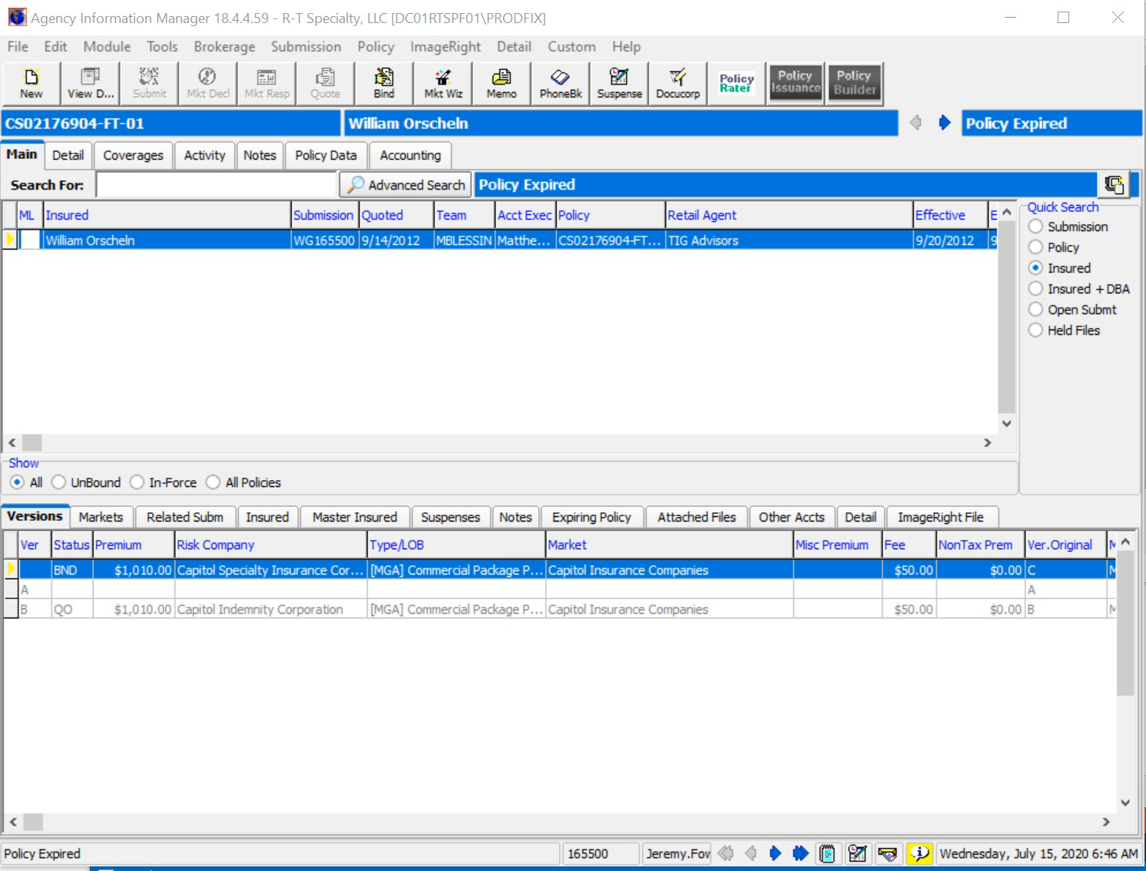
Test the Custom Menu Item

Slide 18
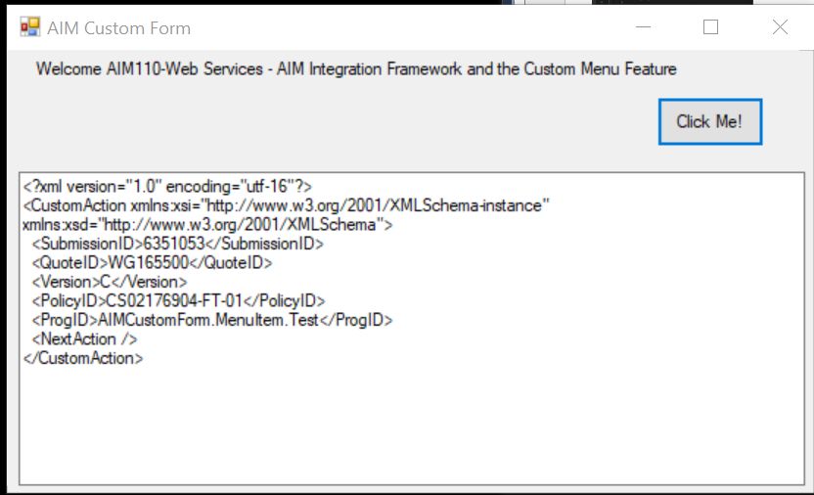
The XML CustomAction Object

Slide 19
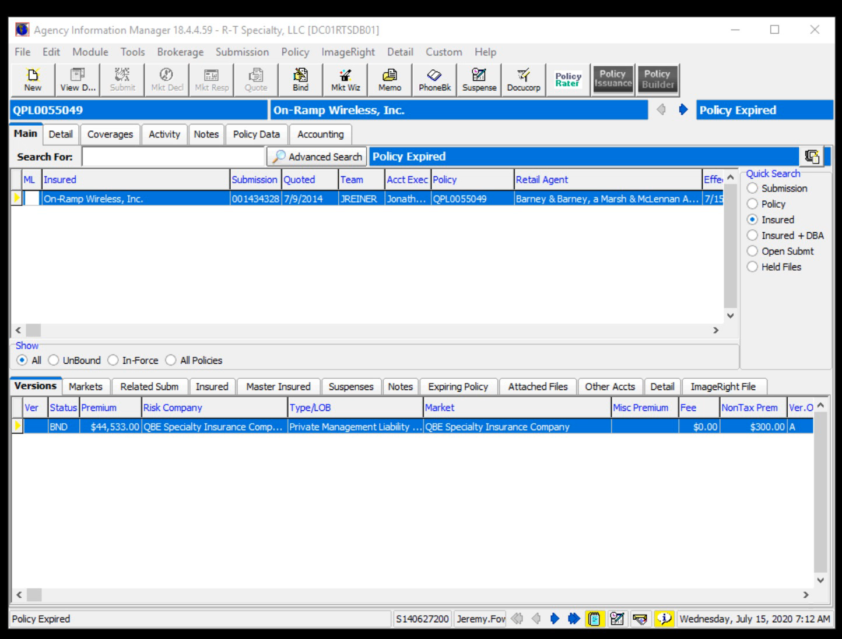
Using a Multiple Custom Menu Items?

Slide 20
Custom Actions
Edit Submission
Edit Insured
Quote button
Bind button
Policy Endorse menu command

Slide 21
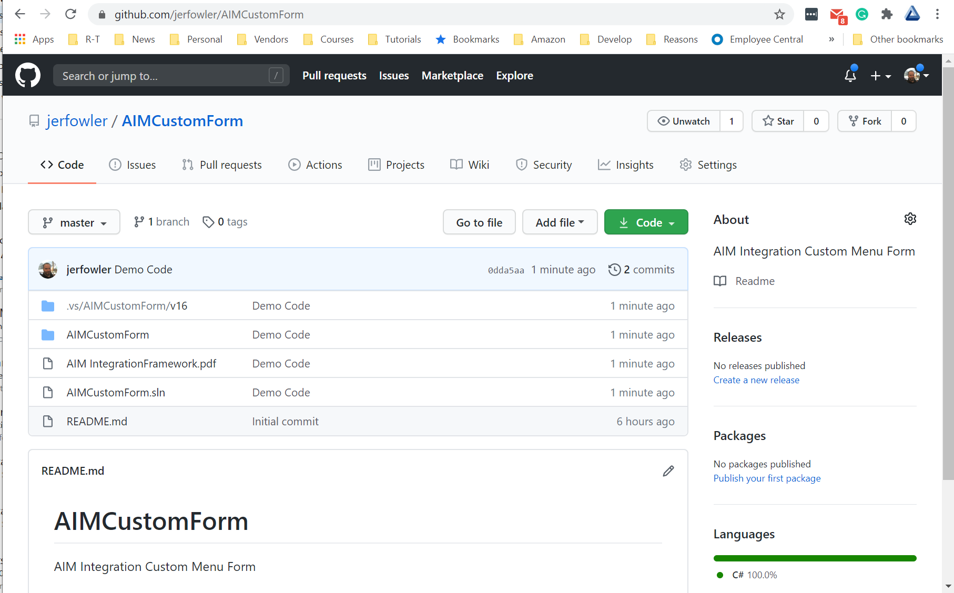
Download the Source Code
https://github.com/jerfowler/AIMCustomForm

Slide 22
Questions?

Slide 23
Thank You!
Be Sure To Rate & Review This Session In The App

